Slide 1
COMP 2230
Week 1 - Friday

Slide 2
Last time
Policies and course overview
Graphing functions
Big-O, Big-Omega, and Big-Theta notation

Slide 3
Questions?

Slide 4
Assignment 1

Slide 5
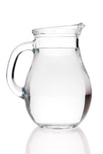
Logical warmup
You have three pitchers whose capacities are three, four, and seven quarts
Only the seven-quart pitcher is full
Pour the fewest times to separate the water into two-, two-, and three-quart quantities

Slide 6
Asymptotic Notations Continued

Slide 7
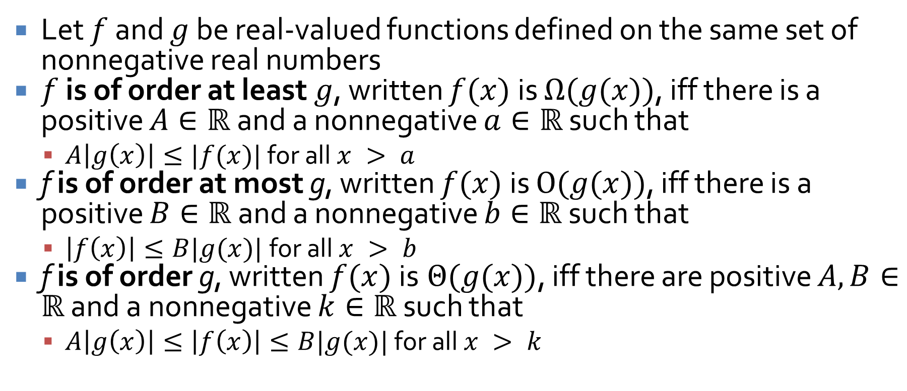
Definitions
Let $f$ and $g$ be real-valued functions defined on the same set of nonnegative real numbers
$f$ is of order at least $g$, written $f(x)$ is $Ω(g(x))$, iff there is a positive $A∈ℝ$and a nonnegative $a∈ℝ$ such that
  $A\left|g\left(x\right)\right|≤|f(x)|$ for all $x > a$
f is of order at most g, written $f(x)$ is $O(g(x))$, iff there is a positive $B∈ℝ$ and a nonnegative $b∈ℝ$ such that
  $\left|f\left(x\right)\right|≤B|g(x)|$for all $x > b$
f is of order g, written $f(x)$ is $Θ(g(x))$, iff there are positive $A, B∈ℝ$ and a nonnegative $k∈ℝ$ such that
  $A\left|g\left(x\right)\right|≤\left|f\left(x\right)\right|≤B|g(x)|$ for all $x > k$

Slide 8
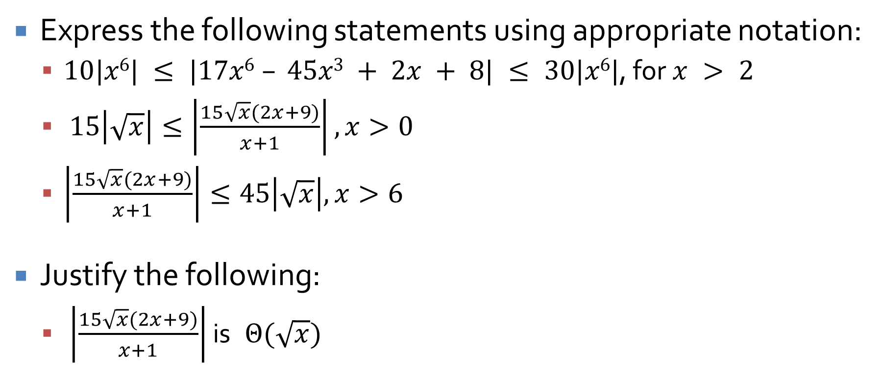
Using the notation
Express the following statements using appropriate notation:
  $10|x6| ≤ |17x6 – 45x3 + 2x + 8| ≤ 30|x6|$, for $x > 2$
  $15\left|\sqrt{x}\right|≤\left|\frac{15\sqrt{x}(2x+9)}{x+1}\right|,x>0$
  $\left|\frac{15\sqrt{x}(2x+9)}{x+1}\right|≤45\left|\sqrt{x}\right|,x>6$
Justify the following:
  $\left|\frac{15\sqrt{x}(2x+9)}{x+1}\right|$ is $Θ(\sqrt{x})$

Slide 9
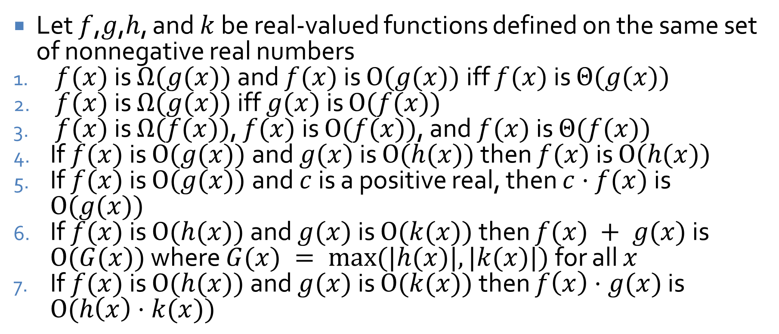

Properties of $Ω$-, $O$-, and $Θ$-notation
Let $f$,$g$,$h$, and $k$ be real-valued functions defined on the same set of nonnegative real numbers
$f(x)$ is $Ω(g(x))$ and $f(x)$ is $O(g(x))$ iff $f(x)$ is $Θ(g(x))$
$f(x)$ is $Ω(g(x))$ iff $g(x)$ is $O(f(x))$
$f(x)$ is $Ω(f(x))$, $f(x)$ is $O(f(x))$, and $f(x)$ is $Θ(f(x))$
If $f(x)$ is $O(g(x))$ and $g(x)$ is $O(h(x))$ then $f(x)$ is $O(h(x))$
If $f(x)$ is $O(g(x))$ and $c$ is a positive real, then $c⋅f(x)$ is $O(g(x))$
If $f(x)$ is $O(h(x))$ and $g(x)$ is $O(k(x))$ then $f(x) + g(x)$ is $O(G(x))$ where $G(x) = max⁡(|h(x)|,|k(x)|)$ for all $x$
If $f(x)$ is $O(h(x))$ and $g(x)$ is $O(k(x))$ then $f\left(x\right)⋅g(x)$ is $O(h\left(x\right)⋅k(x))$

Slide 10

Orders of functions
If $1 < x$, then
  $x < x^{2}$
  $x^{2} < x^{3}$
  …
So, for $r, s∈ℝ$, where $r < s$ and $x > 1$,
  $x^{r} < x^{s}$
  By extension, $x^{r} is O(x^{s})$

Slide 11

Proving bounds
Prove a $Θ$ bound for $g(x) = \frac{1}{4}(x – 1)(x + 1)$ for $x∈ℝ$
Prove that $x^{2}$ is not $O(x)$
  Hint: Proof by contradiction

Slide 12
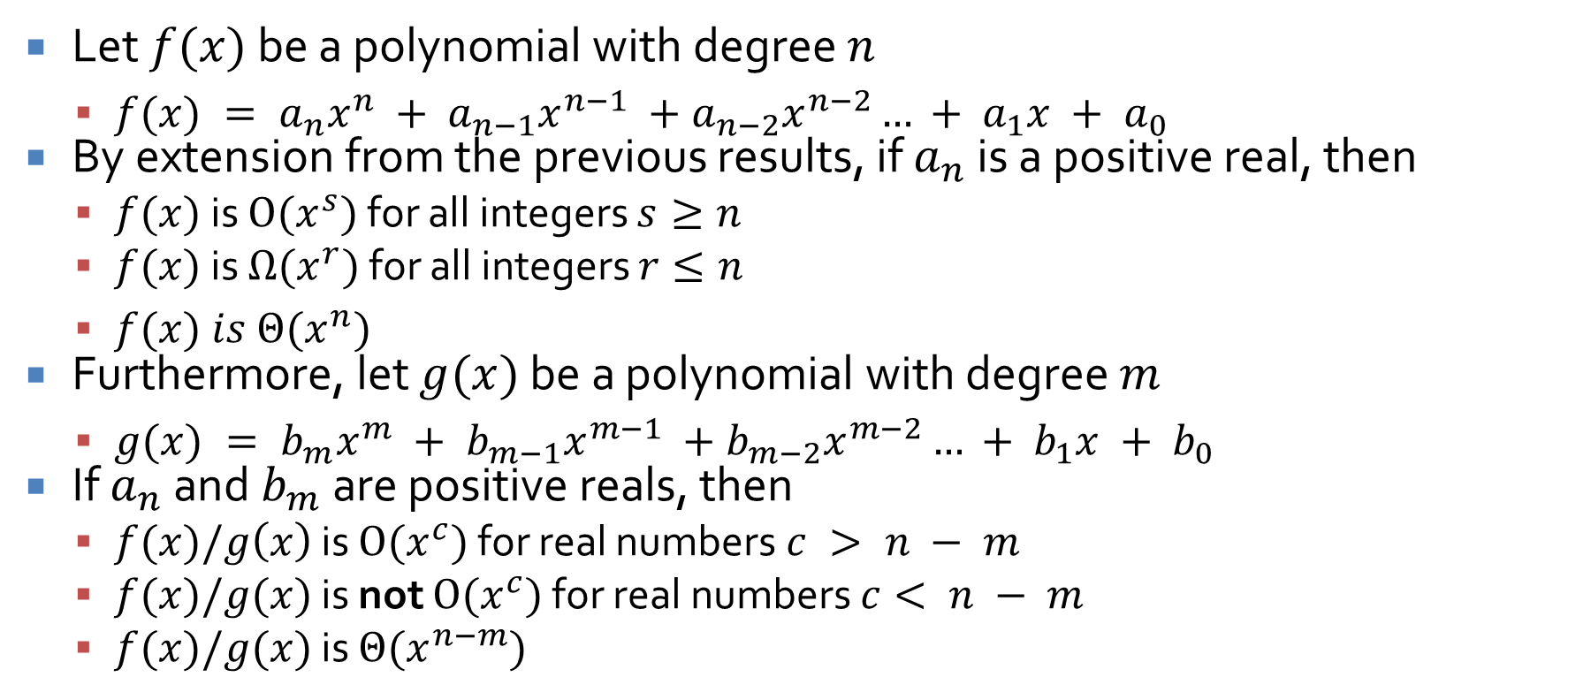
Polynomials
Let $f(x)$ be a polynomial with degree $n$
  $f(x) = a_{n}x^{n} + a_{n−1}x^{n−1} +a_{n−2}x^{n−2}… + a_{1}x + a_{0}$
By extension from the previous results, if $a_{n}$ is a positive real, then
  $f(x)$ is $O(x^{s})$ for all integers $s≥n$
  $f(x)$ is $Ω(x^{r})$ for all integers $r≤n$
  $f(x) is Θ(x^{n})$
Furthermore, let $g(x)$ be a polynomial with degree $m$
  $g(x) = b_{m}x^{m} + b_{m−1}x^{m−1} +b_{m−2}x^{m−2}… + b_{1}x + b_{0}$
If $a_{n}$ and $b_{m}$ are positive reals, then
  $f(x)/g\left(x\right)$ is $O(x^{c})$ for real numbers $c > n − m$
  $f(x)/g(x)$ is not $O(x^{c})$ for real numbers $c< n − m$
  $f(x)/g(x)$ is $Θ(x^{n−m})$

Slide 13
Algorithm Efficiency
Three-Sentence Summary

Slide 14
Algorithm Efficiency

Slide 15
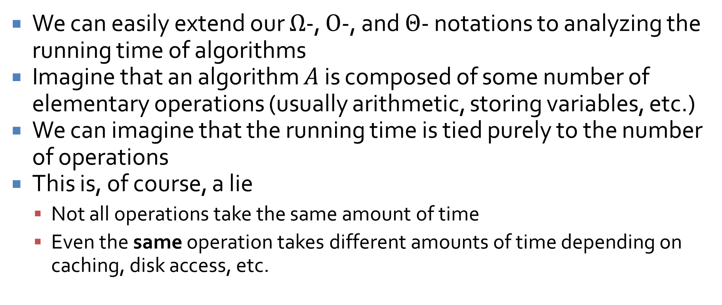
Extending notation to algorithms
We can easily extend our $Ω$-, $O$-, and $Θ$- notations to analyzing the running time of algorithms
Imagine that an algorithm $A$ is composed of some number of elementary operations (usually arithmetic, storing variables, etc.)
We can imagine that the running time is tied purely to the number of operations
This is, of course, a lie
  Not all operations take the same amount of time
  Even the same operation takes different amounts of time depending on caching, disk access, etc.

Slide 16
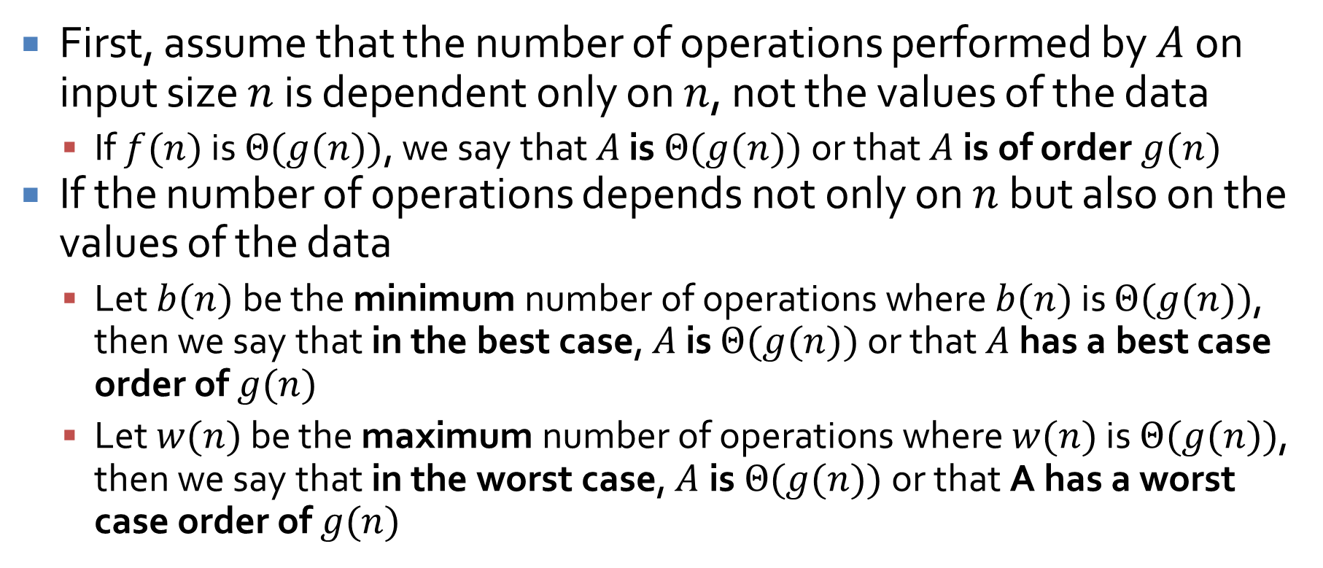
Running time
First, assume that the number of operations performed by $A$ on input size $n$ is dependent only on $n$, not the values of the data
  If $f(n)$ is $Θ(g(n))$, we say that $A$ is $Θ(g(n))$ or that $A$ is of order $g(n)$
If the number of operations depends not only on $n$ but also on the values of the data
  Let $b(n)$ be the minimum number of operations where $b(n)$ is $Θ(g(n))$, then we say that in the best case, $A$ is $Θ(g(n))$ or that $A$ has a best case order of $g(n)$
  Let $w(n)$ be the maximum number of operations where $w(n)$ is $Θ(g(n))$, then we say that in the worst case, $A$is $Θ(g(n))$ or that A has a worst case order of $g(n)$

Slide 17
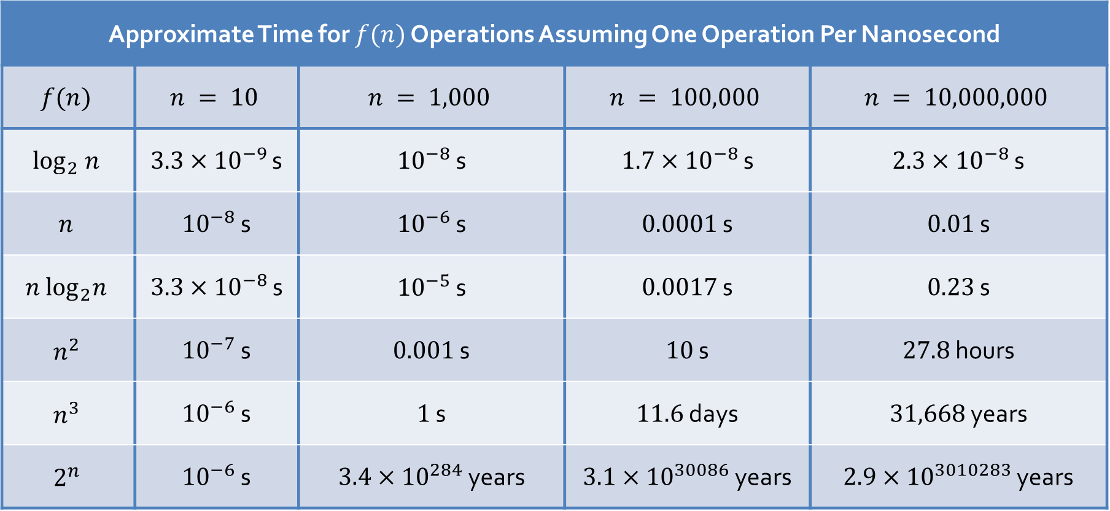
Time
Approximate Time for $f(n)$ Operations Assuming One Operation Per Nanosecond
$$f(n)$$ | $$n = 10$$ | $$n = 1,000$$ | $$n = 100,000$$ | $$n = 10,000,000$$
$$\log_{2} n$$ | $3.3×{10}^{−9}$ s | ${10}^{−8}$ s | $1.7×{10}^{−8}$ s | $2.3×{10}^{−8}$ s
$$n$$ | ${10}^{−8}$ s | ${10}^{−6}$ s | $0.0001$ s | $0.01$ s
$$n \log_{2}n$$ | $3.3×{10}^{−8}$ s | ${10}^{−5}$ s | $0.0017$ s | $0.23$ s
$$n^{2}$$ | ${10}^{−7}$ s | $0.001$ s | $10$ s | $27.8$ hours
$$n^{3}$$ | ${10}^{−6}$ s | $1$ s | $11.6$ days | $31,668$ years
$$2^{n}$$ | ${10}^{−6}$ s | $3.4×{10}^{284}$ years | $3.1×{10}^{30086}$ years | $2.9×{10}^{3010283}$ years

Slide 18
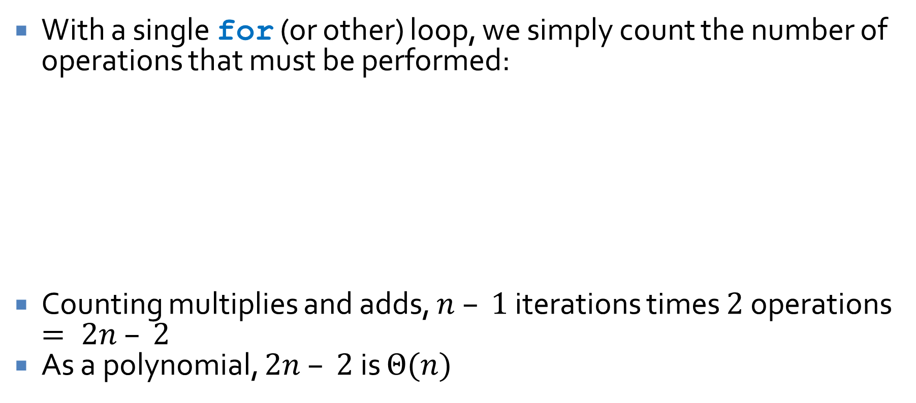
Computing running time
With a single for (or other) loop, we simply count the number of operations that must be performed:
Counting multiplies and adds, $n – 1$ iterations times $2$ operations $= 2n – 2$
As a polynomial, $2n – 2$ is $Θ(n)$
int p = 0;
int x = 2;
for (int i = 2; i <= n; ++i) {
p = (p + i)*x;
}

Slide 19

Nested loops
When loops do not depend on each other, we can simply multiply their iterations (and asymptotic bounds)
Clearly $(n – 1)(n −2)$ is $Θ(n^{2})$
int p = 0;
for (int i = 2; i <= n; ++i) {
for (int j = 3; j <= n; ++j) {
++p;
}
}

Slide 20
Trickier nested loops
When loops depend on each other, we have to do more analysis
What's the running time here?
Arithmetic sequence saves the day
int s = 0;
for (int i = 1; i <= n; ++i) {
for (int j = 1; j <= i; ++j) {
s = s + j*(i – j + 1);
}
}

Slide 21
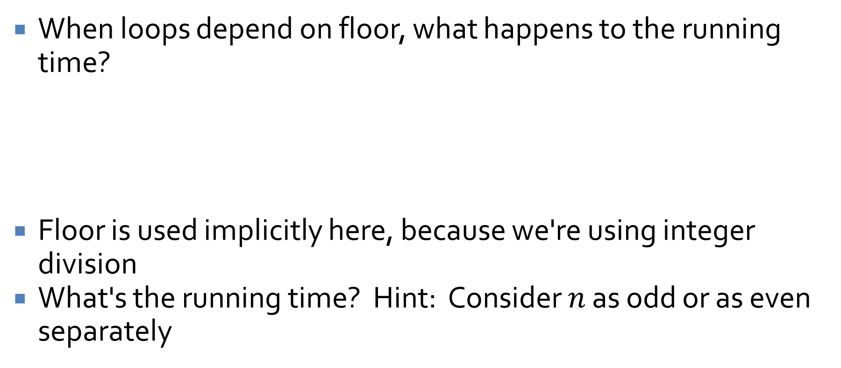
Iterations with floor
When loops depend on floor, what happens to the running time?
Floor is used implicitly here, because we're using integer division
What's the running time? Hint: Consider $n$ as odd or as even separately
int a = 0;
for (int i = n/2; i <= n; ++i) {
a = n - i;
}

Slide 22
Upcoming

Slide 23
Next time…
Finish algorithmic efficiency
Exponential and logarithmic functions

Slide 24
Reminders
Start Assignment 1
Read 11.4
  Prepare a three-sentence summary
Office hours are canceled today

